Slide 1
Cyclist Bike Analysis
By Sebastine Amede
29th May 2023

Slide 2
Project Goal
To gain understanding on the usage pattern of annual members and casual riders
This will help us to:
Develop targeted marketing campaigns
Explore opportunities to convert casual riders to annual members
Identify Patterns Preference and Trend in members usage patterns

Slide 3
Key Questions
What are the average trip duration for different user group?
Are there specific days when bike usage is higher for both groups?
What type of bike do the different groups prefer
What factor influences the choice of bike among user group?

Slide 4
Findings and insights

Slide 5
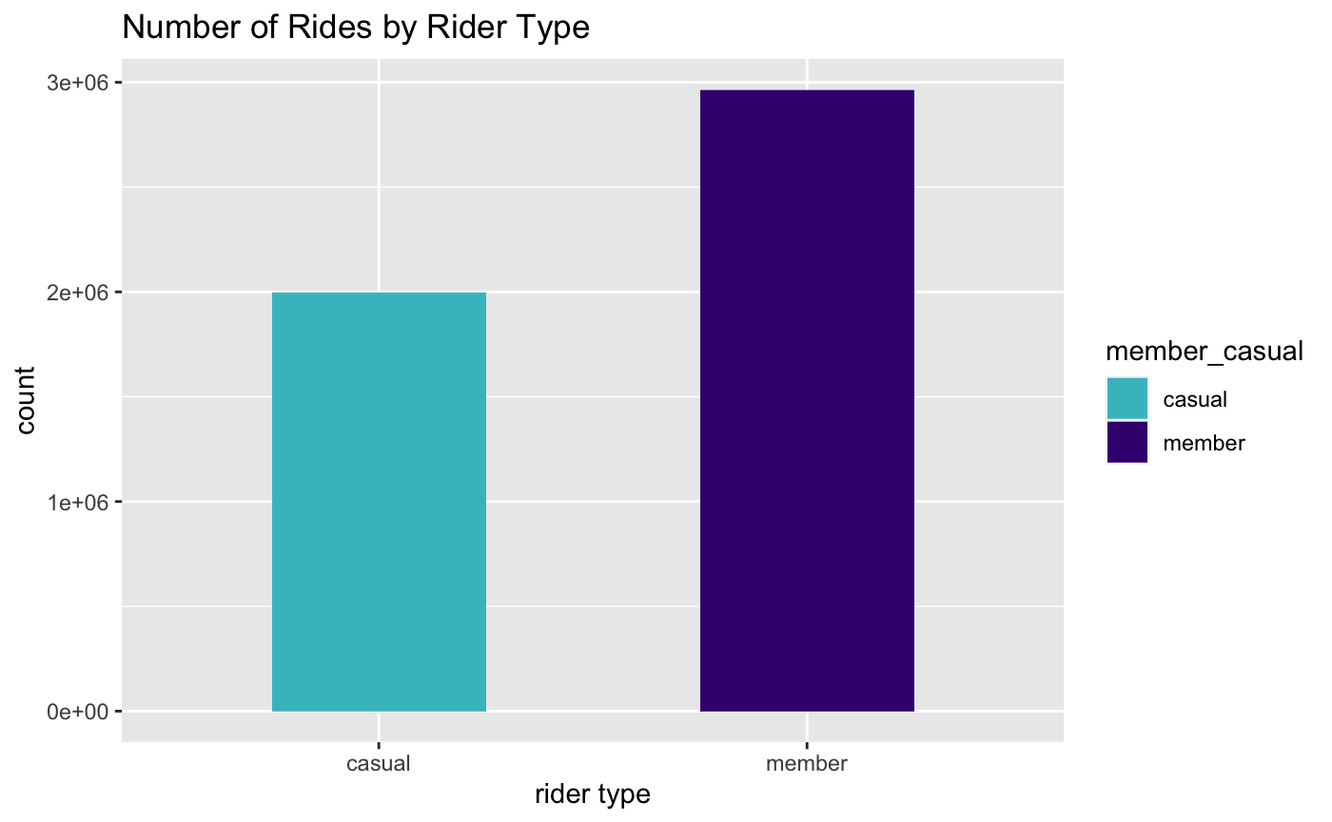
How Trip Vary Among Different User Group
Annual members have a higher number of rides compared to casual members

Slide 6
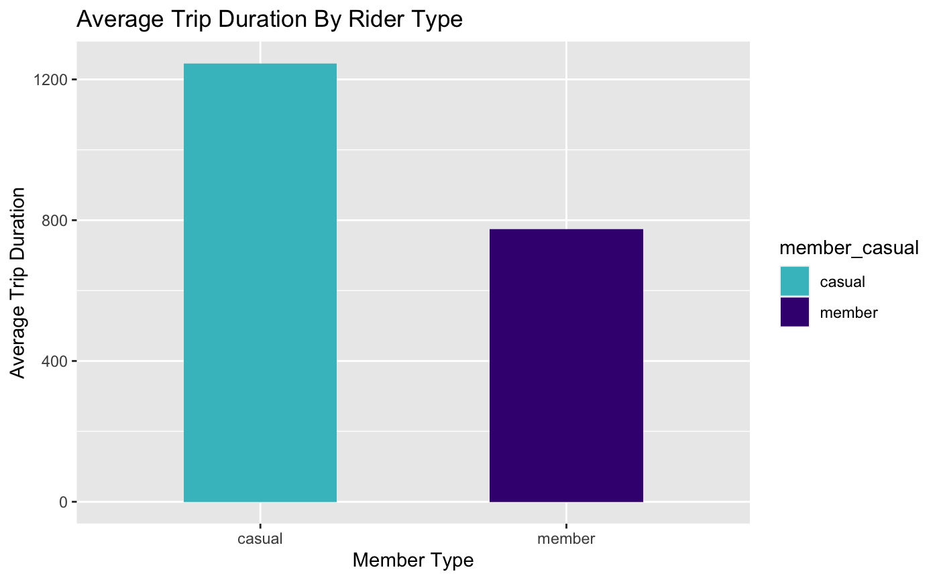
However when it comes to average trip duration, casual members have longer trips compared to annual members.
Possible Reasons:
Casual members may drive more for leisure so choose longer routes
Annual members being frequent riders may be more familiar with the system and shorter routes resulting to shooter trips

Slide 7
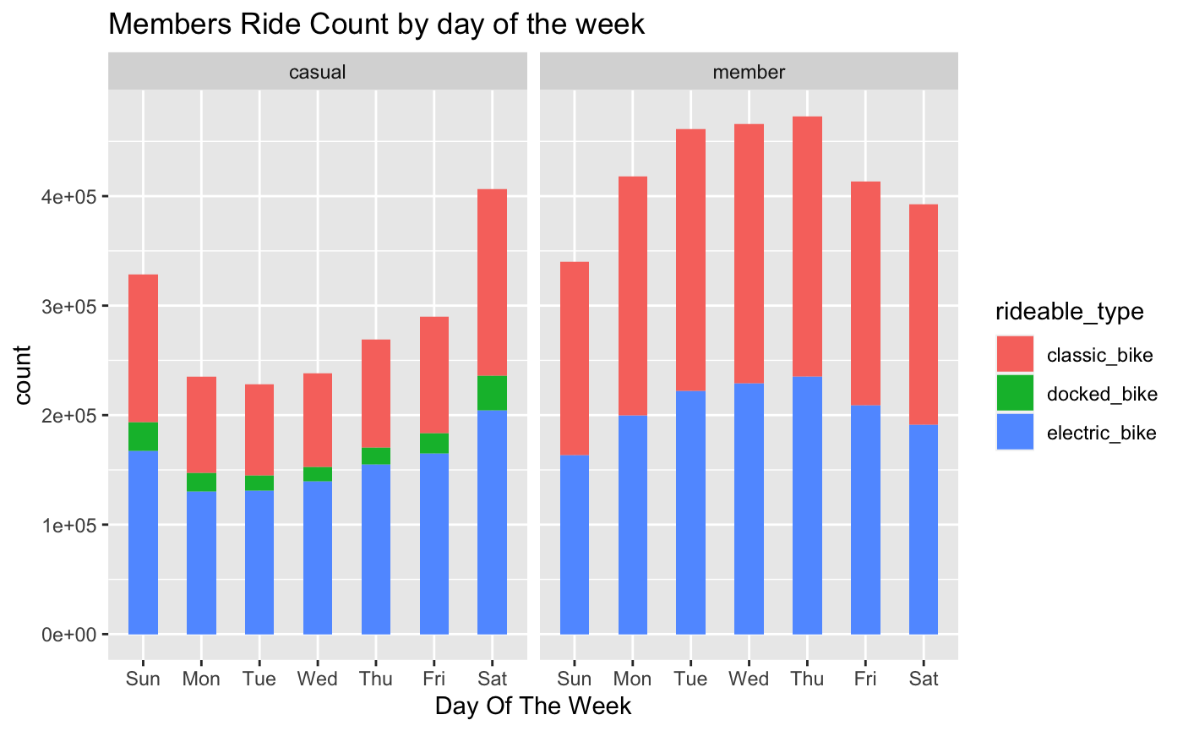
How the user group ride in different days of the week
Weekday pattern: The data suggest that annual members use bike more on weekdays compared to casual riders
Weekend pattern: The data indicate that both users have similar frequency of bike usage during the weekend

Slide 8
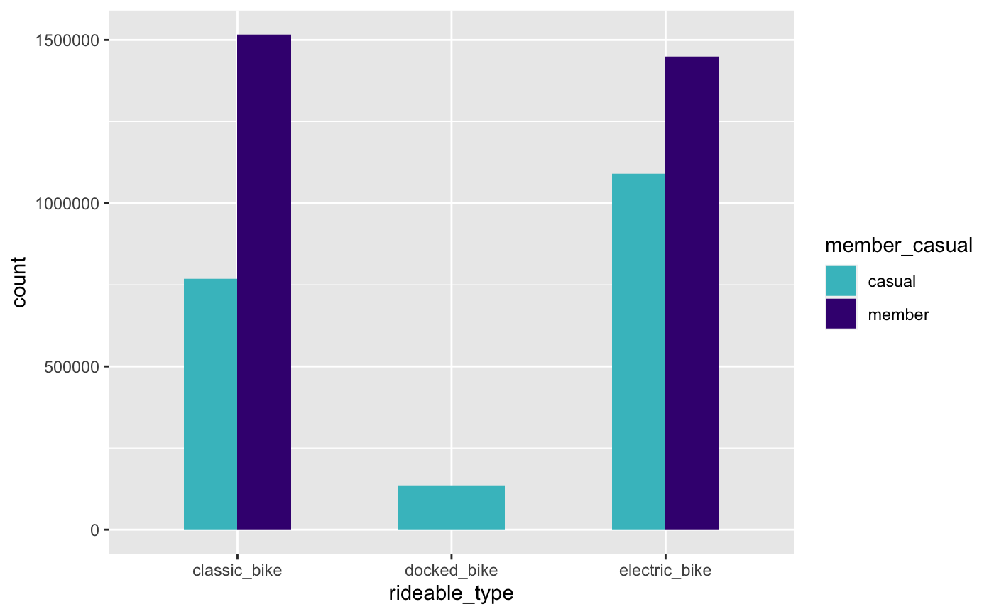
Type of bike different user group prefer
Annual members predominantly use classic bike and electric bike completely avoiding docked bike, casual member on the other hand had low frequency for docked bike usage
Let’s compare percentage distribution ➡️

Slide 9
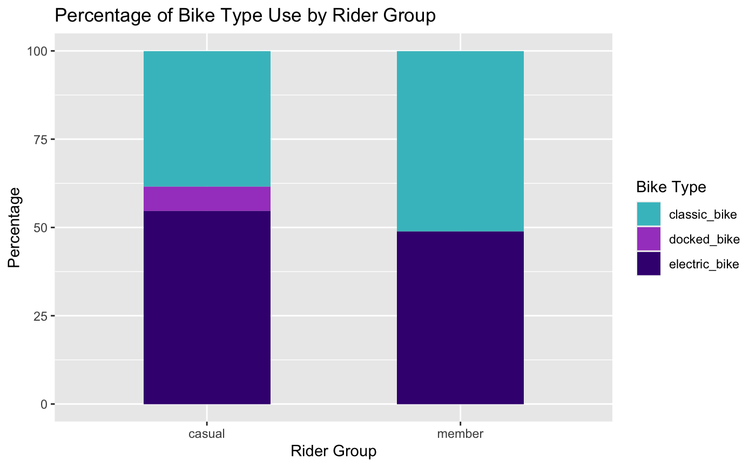

Slide 10
⬅️⬅️⬅️ From the previous slide casual riders prefer electric bikes while annual riders prefer classic bikes, which suggest that there may be different preference and needs among these two groups of riders.
The higher usage of electric bike could be attributed to factors such as convenience, ease of use or desire for more enjoyable experience.
On the other hand, the preference for classic bike among annual members suggest a preference for a more traditional biking experience. Could be influences by factors such as familiarity with this bike, a sense of comfort and control.

Slide 11
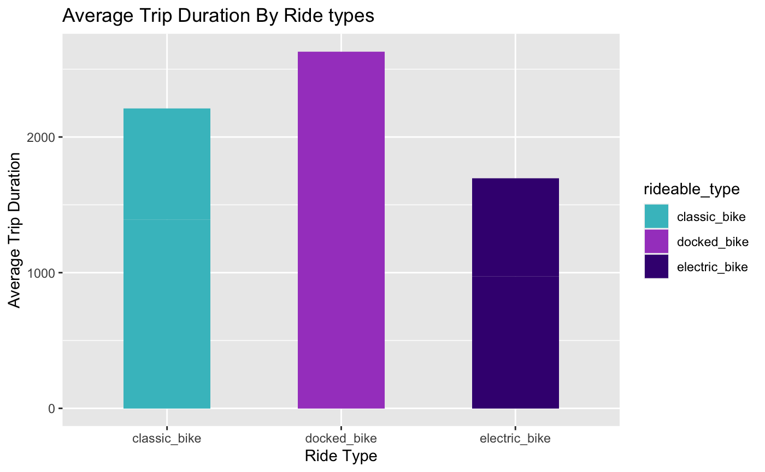
Trip Duration among bike types
Docked bike have the highest average trip duration despite not being used by annual members and rarely used by casual members

Slide 12
Summary of findings
Usage Pattern:
Annual members ride more on the week day
Casual members ride more on the weekend
Bike usage:
Annual members do not use docked bike, while casual members use them with low count
Classic bike account for 51.1% of annual member’s total ride in 2022
Electric bike account for 54.67% of casual member’s total ride in 2022
Trip duration:
Docked bikes have the highest mean trip duration and mean trip distance. This could indicate that casual members who use docked bikes tend to take longer rides compared to other ride types.
Annual members have higher total ride count
Casual members have higher average trip duration

Slide 13
Actions and Recommendation

Slide 14
Recommended Action:
Marketing Recommendation:
Conduct user surveys or feedback sessions with both casual members and potential annual members to provide valuable insights into their preferences, needs, and expectations regarding docked bike usage.
Targeted Marketing for Docked Bikes: Develop marketing strategies that highlight the benefits of using docked bikes, such as their reliability, availability, and suitability for longer rides.
Weekday Commuter Programs: Implement commuter-focused programs and incentives to target potential annual members.
Product Recommendation:
Ensure a sufficient supply of electric bikes and classic bikes based on the preferences of different rider groups.
Docked bike stations should be strategically placed along popular commuting routes or near public transportation hubs, to facilitate seamless multi-modal transportation options for both casual members and annual members.

Slide 15
Gracias, Obrigado, Thank you.

